Slide 1
Email Spam Classifier - Project
Author :
Neha Kumari

Slide 2
Email Spam Classifier - binary Label Classification Project using ML
It uses a binary type of classification containing the labels such as ‘ham’ (nonspam) and spam. Application of this can be seen in Google Mail (GMAIL) where it segregates the spam emails in order to prevent them from getting into the user’s inbox.

Slide 3
Problem Statement
Spam is a waste of time to the user since they have to sort the unwanted junk mail and it consumed storage space and communication bandwidth.

Slide 4
Binary –Label Classification Problem
Binary classification is the simplest kind of machine learning problem. The goal of binary classification is to categorise data points into one of two buckets: 0 or 1, true or false, to survive or not to survive, blue or no blue eyes, etc

Slide 5
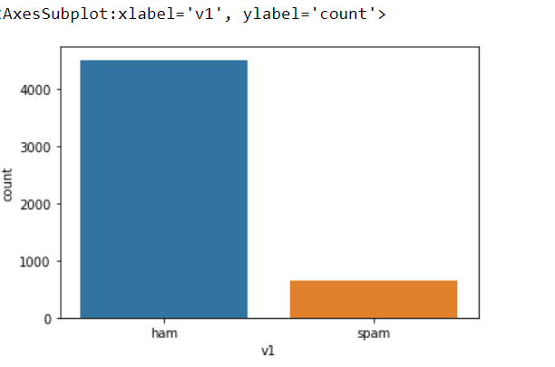
Exploration of Target Variable
From the above countplot, ham mail is more than spam mail

Slide 6
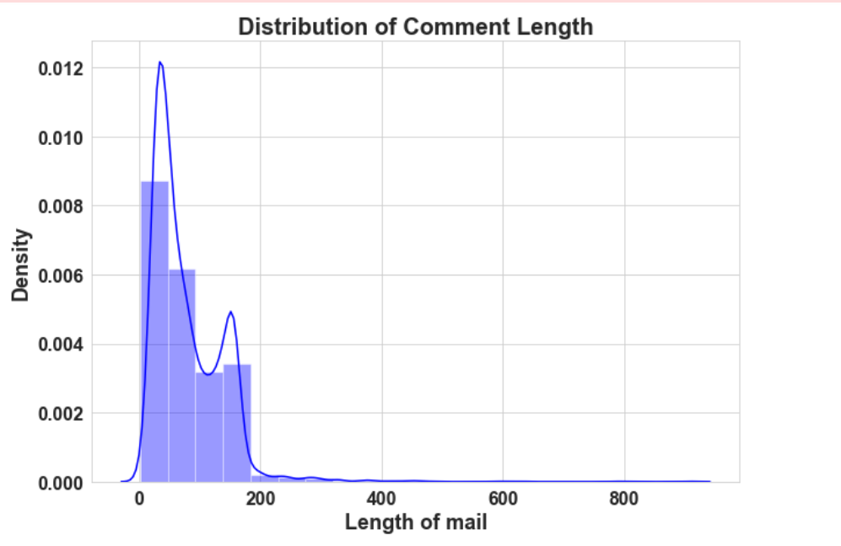
Above is a plot showing the mail length frequency. As noticed, most of the comments are short with only a few comments longer than 200 words.
Majority of the comments are of length 100, where maximum length is 800 and minimum length is 5. Median length being 50.

Slide 7
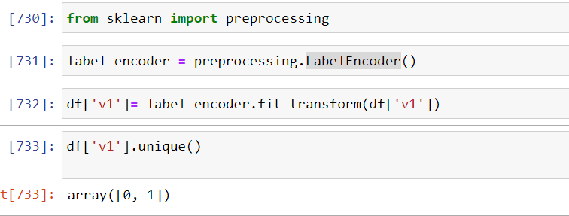
Encording the target variable
I am using a LabelEncoder method For encording the target variable

Slide 8
Data Pre Processing
Convert the text to lowercase
Remove the punctuations, digits and special characters
Tokenize the text, filter out the adjectives used in the review and create a new column in data frame
Remove the stop words
Stemming and Lemmatising
Applying Text Vectorization to convert text into numeric

Slide 9
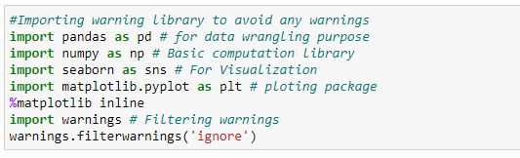
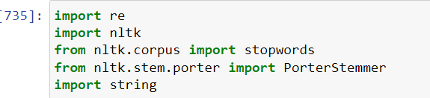
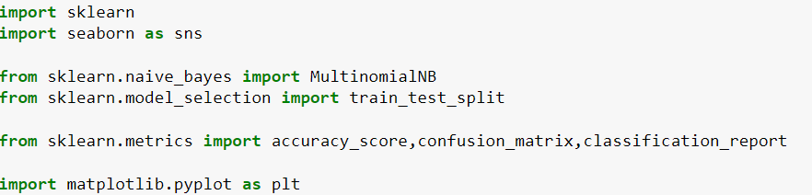
Visualization & Data Wrangling Library used
Text Mining Library used
Machine Learning Model Building Library used

Slide 10
Machine Learning Model Building

Slide 11
Machine Learning Model Building
I have used the Naïve Bayes classifier: It is a supervised machine learning algorithm where words probabilities play the main rule here. If some words occur often in spam but not in ham, then this incoming e-mail is probably spam. Naïve bayes classifier technique has become a very popular method in mail filtering software.
from sklearn.naive_bayes import MultinomialNB

Slide 12

Accuracy Score
MultinomialNB has given the around 95% accuracy score, which is the good accuracy score

Slide 13
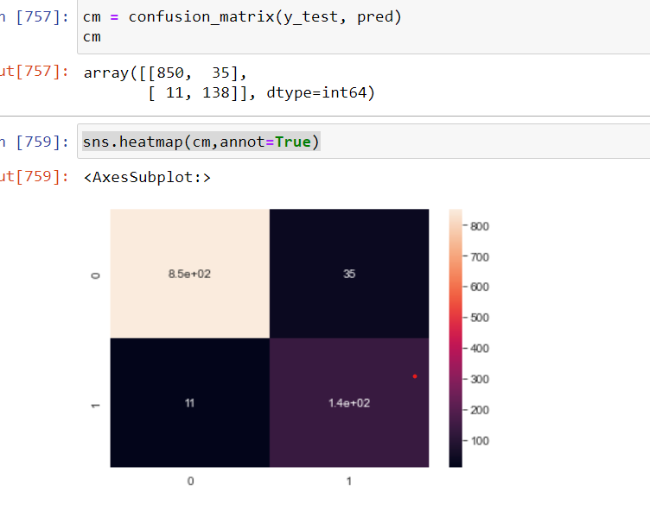
Confusion_matrix

Slide 14
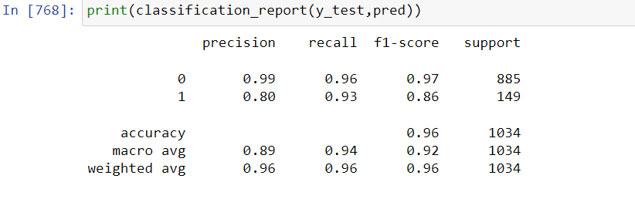
Classification_report

Slide 15
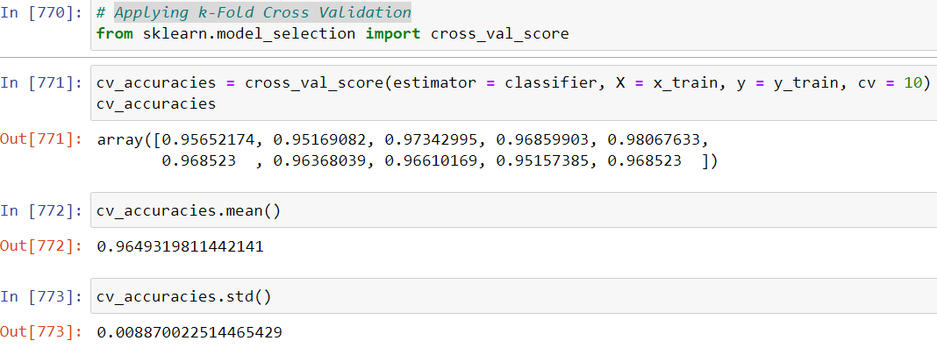
Applying k-Fold Cross Validation

Slide 16
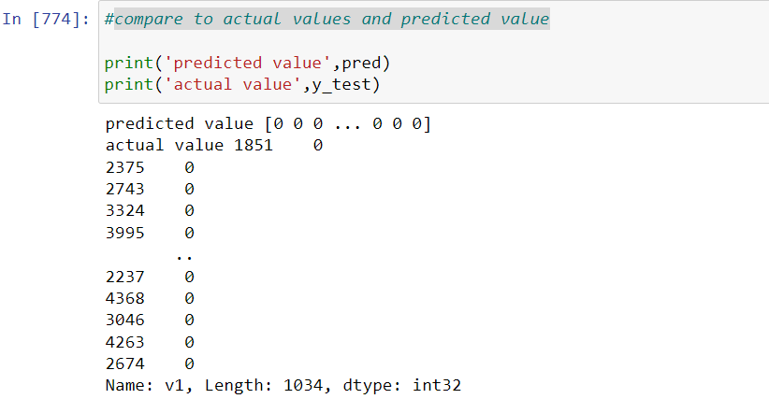
Compare to actual values and predicted value

Slide 17
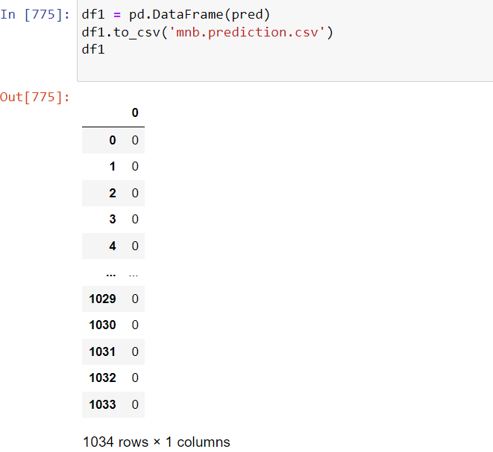
Finally, we had predicted over the data and the predictions obtained were saved in a csv file.

Slide 18
CONCLUSION
I have apply only one machine algorithm (Naïve Bayes classifier) Naïve bayes classifier technique has become a very popular method in mail filtering software. which is given the good score.

Slide 19
Limitations of this work and Scope for Future Work
The machine learning model used by Google have now advanced to the point that it can detect and filter out spam and phishing emails with about 99.9 percent accuracy. The implication of this is that one out of a thousand messages succeed in evading their email spam filter.

